Slide 1
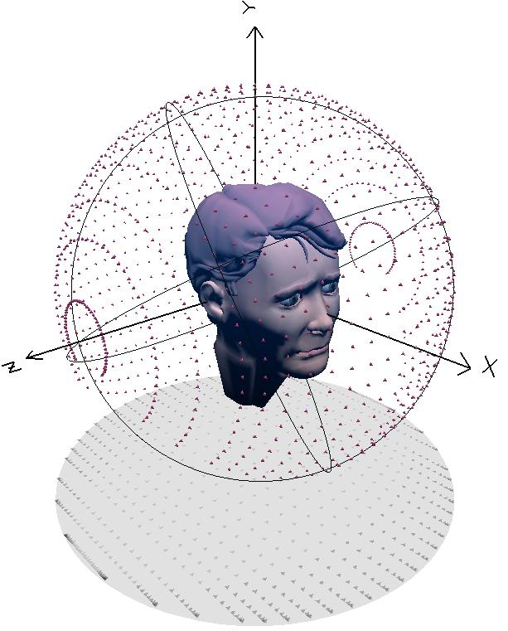
Spatial Audio

Slide 2
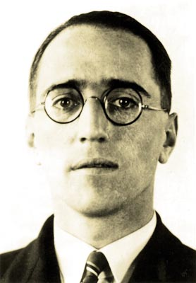

Historical aside: origin of stereo
Early sound systems in theatres had only one channel
Separation between location of actor on screen and location of voice
Alan Blumlein (1903-1942)
Researcher at EMI
1931, Blumlein takes wife to the cinema
‘Do you realise the sound only comes from one person?’
‘Oh does it?’
‘Yes. And I’ve got a way to make it follow the person.’
Resulting patent
"Improvements in and relating to Sound transmission, Sound-recording and Sound-reproducing systems". Application date Dec. 14, 1931, British patent No. 394325.
Notes:
In early 1931, Blumlein and his wife were at a local cinema. The sound reproduction systems of the early 'talkies' invariably only had a single set of speakers - which could lead to the somewhat disconcerting effect of the actor being on one side of the screen whilst his voice appeared to come from the other. Blumlein declared to his wife that he had found a way to make the sound 'follow' the actor across the screen.
The genesis of these ideas is uncertain, but he explained them to Isaac Shoenberg in the late summer of 1931. His earliest notes on the subject are dated 25 September 1931, and his patent had the headline "Improvements in and relating to Sound-transmission, Sound-recording and Sound-reproducing systems". Application date was Dec. 14, 1931, No. 34,657/31, complete left: Nov. 10, 1932, and complete accepted: June 14, 1933 as British patent No. 394325.

Slide 3
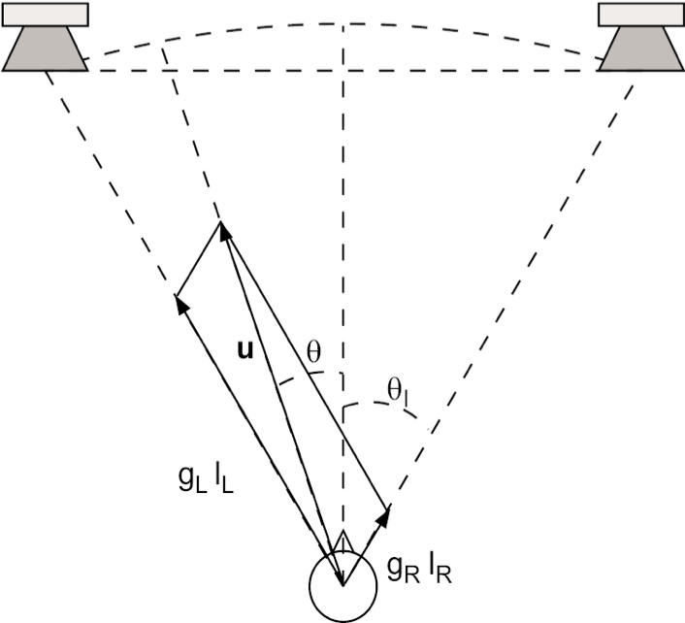
Basics
Spatial audio is the virtual positioning of sounds in space
Simplest case of spatial audio is stereo panning
Moving apparent source of sound between two speakers
Central listener and 60°
angle with two speakers
θ = angle of apparent source
θl = angle of each speaker
Notes:
For reproduction via multiple loudspeakers, it is important to take some specific aspects of localization into account. In fact, different and sometimes contradictory cues come into play when multiple sources radiate coherent or partially coherent signals. Particularly important is the case of a listener hearing signals arriving from the sources only at slightly different levels and times. In this case the sources will cooperate to provide a single sound event located at a place different from the source locations. For larger differences in the incoming signal the virtual sound images tend to collapse onto one of the real sources. The precedence effect is largely responsible for this phenomenon.

Slide 4
Panorama
Panning is changing apparent position of virtual source
feed channels same signal
Adjust relative amplitude of channels
usually accomplished by sound engineer for each sound source
composing panorama of acoustic events in space spanned by loudspeakers
Notes:
Using a multichannel sound reproduction system we can change the apparent position of a virtual sound source just by feeding the channels with the same signal and adjusting the relative amplitude of the channels. This task is usually accomplished, as part of the mixdown process, by the sound engineer for each sound source, thus composing a panorama of acoustic events in the space spanned by the loudspeakers.

Slide 5
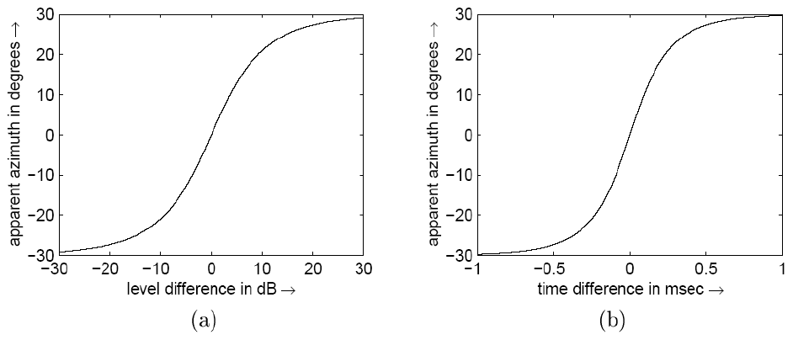
Blumlein law
Perceived azimuth of sound source as function of difference in stereo level
For broadband signals (approximately):
Known as sine law or Blumlein law
θL is angle from listener to each speaker
θ is apparent source angle
Notes:
The figure shows the kind of curves that it is possible to draw from experiments with a standard stereo layout (i.e. central listener and angle of 60º with the loudspeakers) and with broadband impulses as test signals.
The figure shows the perceived displacement for a given level difference. The curve for level difference is well approximated by the Blumlein law.
Gains equal: sinθ=0
All left: sinθ=sinθ_{L}
All right: sinθ=-sinθ_{L}
g_{L}=2g_{R}: sinθ=(sinθ_{L})/3
g_{L}=g_{R}/2: sinθ=-(sinθ_{L})/3

Slide 6
Precedence effect
Sounds from different locations arrive at ears at different times
Step toward one speaker→ monophonic source will appear localised to that speaker
Effect persists despite changes in volume between speakers!
Psychoacoustic phenomenon: precedence effect
Spatial processing inhibited for tens of milliseconds after localised acoustic event
Exploit this by inserting delay in an audio channel
Notes:
Particularly important is the case of a listener hearing signals arriving from the sources only at slightly different levels and times. In this case the sources will cooperate to provide a single sound event located at a place different from the source locations. For larger differences in the incoming signal the virtual sound images tend to collapse onto one of the real sources. The precedence effect is largely responsible for this phenomenon.
In a stereo loudspeaker set-up, if we step to one side of the central position and listen to a monophonic music program, we locate the apparent sound source in the same position as our closest loudspeaker, and the apparent position does not move even if the other channel is significantly louder. The fact that the apparent source collapses into one of the loudspeakers is due to the precedence effect, a well-known perceptual phenomenon that can be exploited in certain musical situations.
Our hearing system is very sensitive to the direction of the first incoming wavefront, so that conflicting cues coming after the first acoustic impact with the source signal are likely to be ignored. It seems that spatial processing is inhibited for a few tens of milliseconds after the occurrence of a well-localized acoustic event. This is the precedence effect. Clearly, the first wavefront is related to a transient in sound production, and transients are wideband signals exciting a wide frequency range where the directional properties of the outer ear can be used to give a hint of incoming direction.
In a standard stereo loudspeaker set-up, with the listener in central position as in the figure, a monophonic source material that feeds both loudspeakers with the same loudness can be moved towards one of the loudspeakers just by inserting some delay in the other channel.

Slide 7
Gain and delay
Two primary tools for placing sounds in space
> 1ms or > 30dB: sound localised to one source
Two simultaneous sounds
with level difference
Two equal amplitude sounds
with time difference

Slide 8
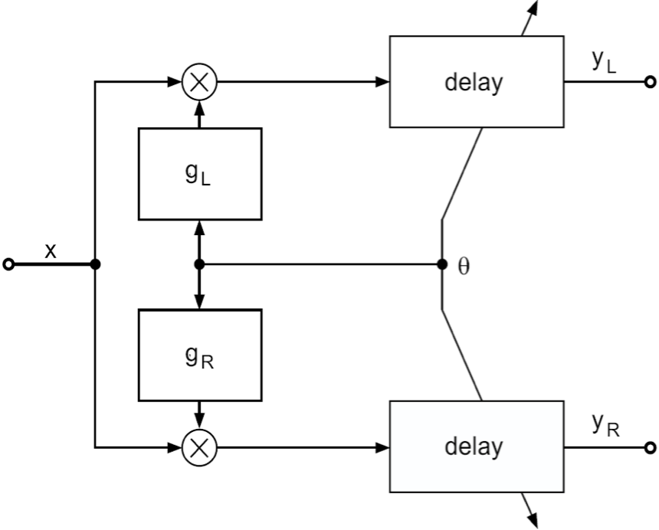
Gain and delay
Joint control of panorama and precedence effects
Use variable-length delay lines
Notes:
The previous figure shows the qualitative dependency of the apparent azimuth on the relative delay between channels. The actual curve strongly depends on the kind of sounds that are played.
A simple circuit allowing a joint control of panorama and precedence effect is shown in the figure. The variable-length delay lines should allow delays up to 1ms.
In a live performance, it is often desirable to keep all the apparent sound sources in the front, so that they merge nicely, both acoustically and visually, with the sounds coming from acoustic instruments on stage. However, if only the front loudspeakers are playing it might be difficult to provide all the audience with a well-balanced sound, even at the seats in the rear. A good solution, called transparent amplification, is to feed the rear loudspeaker with a delayed copy of the front signals. The precedence effect will ensure that the apparent location is on stage as long as the delay of the rear signals is at least as long as the time taken by sounds to go from the stage to the rear loudspeakers. Given the length of the room L and the speed of sound c, the delay in seconds should be about
T_{D}=L/c

Slide 9
Rotation matrix
Gains applied to 2 channels in order to steer sound source to desired aziumuth obtained by matrix vector multiplication
Aθ is the rotation matrix
When θL is 45° we have:

Slide 10
Panning & Precedence Implementation
Sources placed in apparent location using
delay
amplitude
Sound from just one side
1 ms delay
>30dB amplitude difference between 2 equally spaced speakers
Source appear half way between center & speaker
0.2ms delay between right & left speaker
Approximately 6dB amplitude difference between right & left channels
Notes:
Sound sources can be “placed” in an apparent location using two factors: delay and amplitude. A delay of 1 ms is enough to give the impression of coming almost completely from one side. A difference in amplitude of 30dB or more between two equally spaced speakers will have a similar effect.
A sound source can be made to appear approximately half way between the center and the speaker by introducing a delay of 0.2 ms between the right and the left speaker.
The equivalent amplitude difference to produce this same effect is approximately 6dB between the right and left channels.

Slide 11
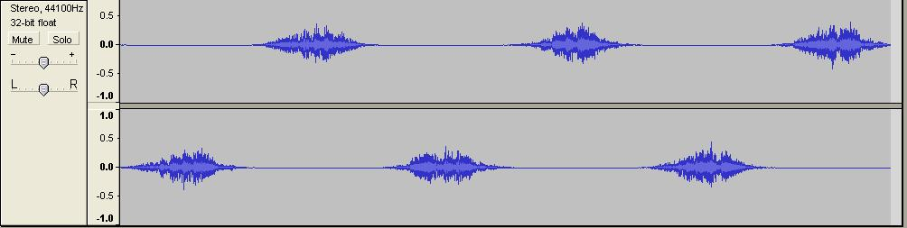

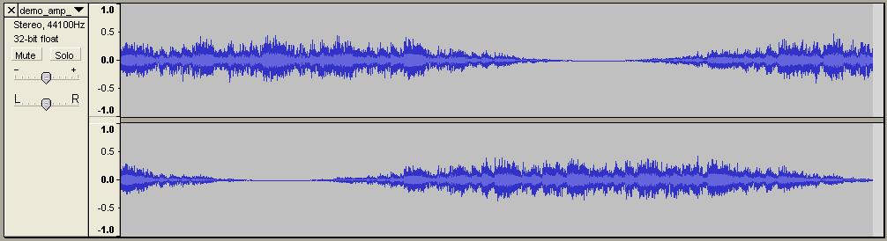
Panning examples
First case: linear gain adjustment between channels
Produces hole in the sound as it travels to centre
Second case: rotation matrix
Consistent positioning and amplitude of sound

Slide 12
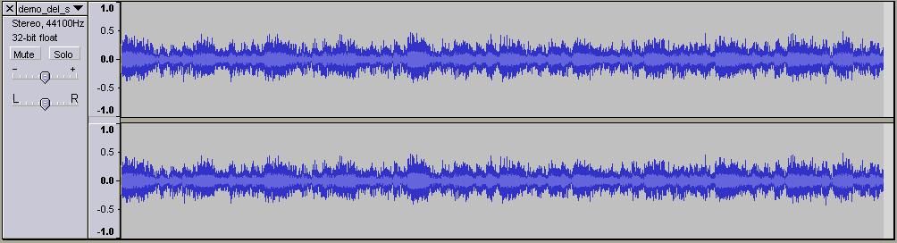
Precedence example
Start with right channel delayed 1ms
Gradually change delay until left channel delayed 1ms
Sound source moves from left to right
Identical levels

Slide 13
Transparent amplification
How to reinforce live sound?
Example: amplifying acoustic instruments on stage
Want apparent sound sources to merge nicely, acoustically and visually, with sounds from acoustic instruments on stage
Possible solution: only front loudspeakers
Sound is not uniform throughout space
Better solution: transparent amplification
Feed rear speakers with delayed signal
Ensures localisation to stage as long as live stage sound always arrives first
Minimum delay depends on distance from stage
Minimum delay for room length L, speed of sound c
T_{D}=L/c (sec)
Notes:
In a live performance, it is often desirable to keep all the apparent sound sources in the front, so that they merge nicely, both acoustically and visually, with the sounds coming from acoustic instruments on stage. However, if only the front loudspeakers are playing it might be difficult to provide all the audience with a well-balanced sound, even at the seats in the rear. A good solution, called transparent amplification, is to feed the rear loudspeaker with a delayed copy of the front signals. The precedence effect will ensure that the apparent location is on stage as long as the delay of the rear signals is at least as long as the time taken by sounds to go from the stage to the rear loudspeakers. Given the length of the room L and the speed of sound c, the delay in seconds should be about
T_{D}=L/c

Slide 14
Head-related transfer function
Panning and precedence give azimuth cues
Based on Interaural Time Difference (ITD) and Interaural Level Difference (ILD)
What about elevation?
How do we localise sound front-to-back?
Head-Related Transfer Function (HRTF)
Torso, head and outer-ear perform elevation-dependent filtering of sounds before they reach inner ear
Filtering effects resolve ambiguity in ITD and ILD
Filtering can be artificially simulated
Notes:
Two of the primary cues we use for localization are Interaural Time Differences (ITD) and Interaural Level Differences (ILD) created between the two ears by sounds from a particular point in space. However, these are ambiguous cues and they do not lend any information about the elevation of a sound source. However the torso, head, and outer ear do perform elevation-dependent spectral filtering of sounds before they reach the inner ear. This affect is commonly called a Head Related Transfer Function (HRTF). This aids in resolving the ambiguity from the ITDs and ILDs alone and helps us localize sounds in free space.

Slide 15
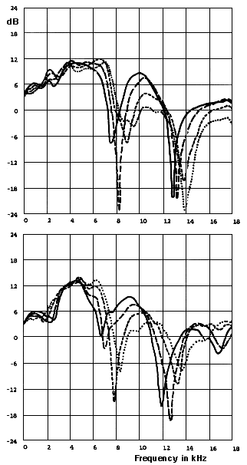
HRTFs
HRTFs are unique
But patterns emerge
HRTFs for 2 subjects
Sound 2 meters to left of subject
moved from ear level (0 degrees) to elevation 30 degrees above
solid line: 0 degrees
long dashes: 10 degrees
short dashes: 20 degrees
dotted line: 30 degrees
Notes:
From http://www.sfu.ca/sonic-studio/handbook/Pinna.html
Head-related transfer functions (HRTF) for two subjects illustrating spectral colouration for increasing source elevation in the lateral plane. The sound was located 2 meters to the left of the subject and was moved from ear level (0 degrees) to an elevation 30 degrees above ear level (solid line: 0 degrees; long dashes: 10 degrees; short dashes: 20 degrees; dotted line: 30 degrees). From G. Kendall & W. Martens, "Simulating the cues of spatial hearing in natural environments," Proceedings of the 1984 International Computer Music Conference.

Slide 16
Head shadowing
Head shadowing = sound travelling through or around head to reach inner ear
Head can produce significant attenuation
Also filtering effect, usually lowpass filter
Model: diffraction of plane wave around rigid sphere
Head shadowing can cause perception problems with linear distance and direction
Notes:
Head shadow is a term describing a sound having to go through or around the head in order to reach an ear. The head can account for a significant attenuation (reduced amplitude) of overall intensity as well as provides a filtering effect. The filtering effects of head shadowing cause one to have perception problems with linear distance and direction of a sound source.
Starting from the approximation of the head as a rigid sphere that diffracts a plane wave, the shadowing effect can be effectively approximated by a first-order continuous-time system

Slide 17
Head Shadowing and ITD
a – effective radius of head
θ – azimuth
α – position of the zero
HRTF
ITD – modelled as first order allpass filter

Slide 18
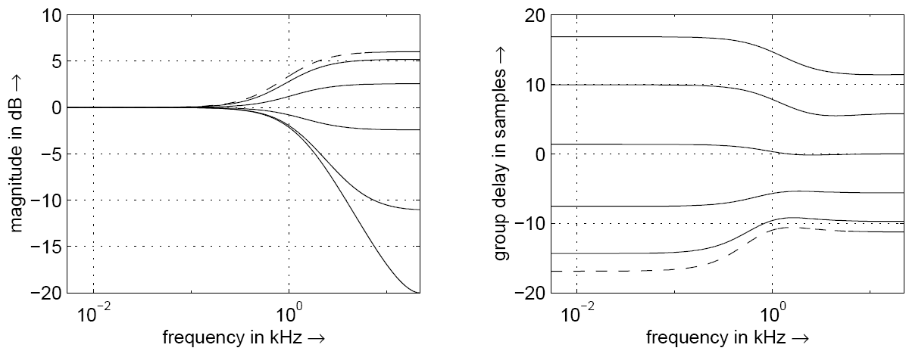
Head shadowing and ITD
Magnitude and group delay of head shadowing / ITD block
Azimuth from 0 (dashed) to π in steps of π/6

Slide 19
Pinna reflections
Pinna (pl. pinnae) or auricle: outer part of the ear
Important to sound localisation
Reflect incoming sound in ways depending on source angle
Distinguishing front and back sources
Sounds from front reflect off pinnae
Sounds from back do not cause reflections
Listening over headphones, sounds without reflections localised to back
This includes most microphone recordings
Perception of height also depends on pinna reflections
Notes:
Latin: pinna = wing; plural: pinnae) The ear flaps or outer part of the ear called the AURICLE.
Recent research indicates that the pinnae are of importance in sound localization since they reflect incoming sound in ways that depend on the angle of the source. Front-back distinctions appear to be made on the basis of the reflections off the various ridges of the pinnae. Since these reflections do not occur for sounds coming from behind, sounds lacking this information (as in most microphone recordings) tend to be localized toward the back of the listener when heard over headphones. Pinna reflections also affect the perception of height.

Slide 20
Pinna parameters
Pinnae provide multiple reflections
Implemented digitally with tapped delay line
Short echoes = notches in frequency domain
Just like case with flanger
Notch location is elevation-dependent
Main perceptual cue for elevation
Formula for time delay of echoes:
Parameters for amplitude and time delay
n | ρpn | A_{n} [samples] | B_{n} [samples] | D_{n} (Approx.)
2 | 0.5 | 1 | 2 | 1
3 | -1 | 5 | 4 | 0.5
4 | 0.5 | 5 | 7 | 0.5
5 | -0.25 | 5 | 11 | 0.5
6 | 0.25 | 5 | 13 | 0.5
ρpn: amplitude of reflections
Dn adjusts to individual pinna characteristics
Notes:
Finally, the pinna provides multiple reflections that can be obtained by means of a tapped delay line. In the frequency domain, these short echoes translate into notches whose position is elevation dependent and that are frequently considered
as the main cue for the perception of elevation. A formula for the time delay of these echoes is given.
The parameters are given in Table together with the amplitude values ρ_{pn} of the reflections. The parameter D_{n} allows the adjustment of the model to the individual characteristics of the pinna, thus providing an effective knob for optimizing the localization properties of the model.

Slide 21
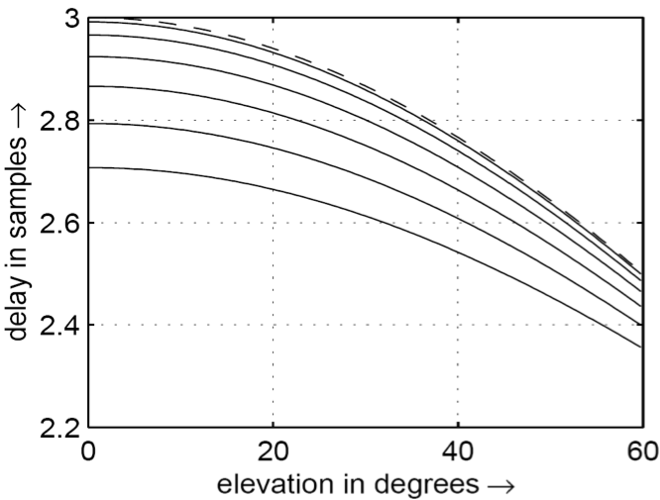
Delay time of first pinna echo
First echo time is function of azimuth and elevation
In this plot, azimuth ranges from 0 to π/2
Steps of π/12
Corresponds to frequency notch between 7-10kHz
Notes:
The parameter D_{n} allows the adjustment of the model to the individual characteristics of the pinna, thus providing an effective knob for optimizing the localization properties of the model. Figure depicts the delay time of the first pinna echo as a function of azimuth and elevation. The corresponding frequency notch lies somewhere between 7 and 10 kHz.
Delay time (in samples at fs = 44100 Hz) of the first echo generated by the pinna as a function of azimuth and elevation. Azimuth ranging from 0 (dashed line) to π/2 at steps of π/12.

Slide 22
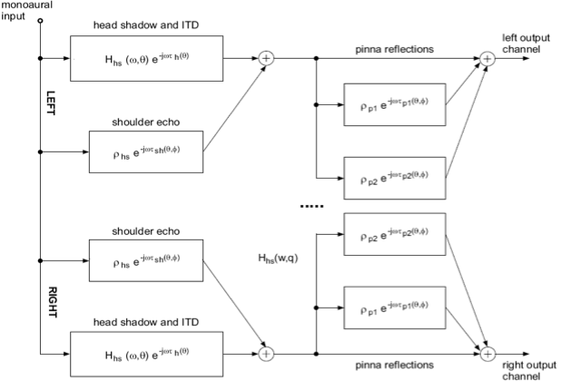
Structural model
Pinna-head-torso
system
Notes:
The structural model of the pinna-head-torso system is depicted in Figure with all its three functional blocks, repeated twice for the two ears. Even though the directional properties are retained by the model, anechoic sounds filtered by the model do not externalize well. As we have explained, there are several ways to improve the externalization in binaural listening.

Slide 23
Head-Related Transfer Function
HRTF implementation based on
head shadowing
ITD
pinna reflections
pinna-reflector - linear interpolation for noninteger delay
important when the delay is small
parameters given in Table are used
do not work equally well for all people
shoulder echo omitted
not particularly important
unknown parameters
head shadowing/ITD most useful & important cue
pinna cues
reinforce perception of azimuth
provide elevation cues
Notes:
This is an implementation of the head-related transfer function based on the textbook's existing hsfilter.m file (modest changes) and an implementation of pinna reflections. The pinna-reflector uses linear interpolation so that it can model a non-integer delay -- which is important when the delay is small. The parameters given in the Table are used, with the cautionary note that they do not work equally well for all people.
The shoulder echo was omitted, because the shoulder echo is not particularly important, and reasonable magnitude parameters are unclear for this effect. The head shadowing/ITD seems to be by far the most useful and important cue; pinna cues are used to reinforce the perception of azimuth and and to provide elevation cues.

Slide 24
Azimuth
azimuth angle measured
0’ is straight ahead
90’ is the right ear
elevation kept at 0’
Both pinna filter & head shadow/ITD applied
45’
135’
225’
315’
Notes:
In these demos the azimuth angle is measured where 0’ is straight ahead, and 90’ is the right ear. The file name indicates the number of degrees of azimuth, with the elevation kept at 0’. Both pinna filter and head shadow/ITD are applied

Slide 25
Elevation
90’ is straight up, –90’ is straight down
Elevation 60’, azimuth 0’
Elevation -60’ , azimuth 0’
HRTF applies filtering even when both azimuth & elevation angles =0
Unprocessed mono
Stereo, elevation 0’, azimuth 0’
elevation harder to notice than azimuth cues
HRTF parameters often need to be fine-tuned to a particular user’s ears.
Notes:
In describing elevation, 90’ is straight up and –90’ is straight down.
Elevation 60’, azimuth 0’
Elevation -60’ , azimuth 0’
HRTF applies filtering even when both azimuth and elevation angles are zero. Compare it with the unprocessed Tom’s diner clip here:
Unprocessed mono Tom’s diner
Stereo, elevation 0’, azimuth 0’
The elevation cues are much harder to notice and pick up on than the azimuth cues. One reason for this, as discussed in the text, is that the HRTF parameters often need to be fine-tuned to a particular user’s ears.

Slide 26
Sweeping
illusion of moving, rotating sound source about listener’s head
perform HRTF processing on small segment
overlap-add with another segment at slightly different azimuth or elevation angle
does not perform processing on input
attempts to smooth different output chunks
360’ clockwise rotation, beginning behind user
azimuth–10’ to 10’, elevation–60’ to 60
Notes:
Using a flexible overlap-add method it is possible to create the illusion of moving, rotating sound source about the listener’s head. The procedure consists of performing HRTF processing on a small segment of the sound file, and then overlap-adding this segment together with another at a slightly different azimuth or elevation angle. The effect is quite convincing and helps immensely in demonstrating to the user that the HRTF is in fact working correctly. The overlap-add does not attempt to perform any processing on the input as one might do in the case of for example time stretching; it simply attempts to smooth different “chunks” out of output.
360’ clockwise rotation, beginning behind the user
azimuth from –10’ to 10’, elevation from –60’ to 60

Slide 27
Code

Slide 28
Rotation matrix
initial_angle = -40; %in degrees
final_angle = 40; %in degrees
segments = 32;
angle_increment = (initial_angle - final_angle)/segments * pi / 180;
% in radians
lenseg = floor(length(monosound)/segments) - 1;
pointer = 1;
angle = initial_angle * pi / 180; %in radians
for i=1:segments
A =[cos(angle), sin(angle); -sin(angle), cos(angle)];
x = [monosound(pointer:pointer+lenseg);
monosound(pointer:pointer+lenseg)];
y = [y, A * x];
angle = angle + angle_increment; pointer = pointer + lenseg;
end;

Slide 29
changing delay of signal over time
Ts = 1/fs;
%shift left to right
delay = .001; % in seconds
shift = round(delay/Ts); %shift time in samples
%right channel starts delayed by 1ms
L = [zeros(shift*2+length(x),1)];
R = [zeros(shift,1);x;zeros(shift,1)];
N = length(L);
samples_per_shift = round(N/(shift*2));
x_index = 1;
%insert extra samples at fixed intervals
for(i=1:N)
L(i) = x(x_index);
if(mod(i,samples_per_shift) ~= 0)
x_index = x_index + 1;
end
end

Slide 30
Crossfading between left and right
Ts = 1/fs;
sweepfreq = .5; %sweep frequency in Hz
u = [2^(-1/2);2^(-1/2)];
g = zeros(2,length(x));
L = zeros(1,length(x));
R = L;
%exponents change from 0 to 3
for(n = 1:length(x))
exL = 1.5*(1+sin(2πn*sweepfreq/fs));
exR = 3 - exL;
L(n) = x(n)*10^{-exL};
R(n) = x(n)*10^{-exR};
end
y = [L',R'];

Slide 31
Change amplitude over time using rotation matrix
Ts = 1/f_{s};
sweepfreq = 0.2; %sweep frequency in Hz
%positive angle to left, negative to right
%Code for changing angle
θ= zeros(1,length(x));
u = [2^{-1/2};2^{-1/2}];
g = zeros(2,length(x));
L = zeros(1,length(x));
R = L;
for(n = 1:length(x))
θ(n)=(π/4)*sin(2πn*sweepfreq/f_{s});
A=[cos(θ(n)),sin(θ(n));-sin(θ(n)),cos(θ(n))];
g(:,n) = A*u;
L(n) = x(n)*g(1,n);
R(n) = x(n)*g(2,n);
end
y = [L',R'];
Code for fixed angle
THETA = pi/6;
A=[cos(θ),sin(θ);-sin(θ),cos(θ)];
g = A*u;
L = g(1)*x;
R = g(2)*x;

Slide 32
Head Shadow and ITD code
θ =θ + 90; θ is angle with frontal plane
θ₀ =150;α_{min} =0.05 ;
c = 334; a =0.0891; speed of sound, radius of head
ω₀ =c/a;
α =1+α_{min}/2 + (1-α_{min}/2)* cos(θ/θ₀*π);
numerator of Transfer Function
B = [(α+ω₀/f_{s})/(1+ ω₀/f_{s}), (-α+ω₀/f_{s})/(1+ ω₀/f_{s})];
denominator of Transfer Function
A = [1, -(1- ω₀/f_{s})/(1+ ω₀/f_{s})] ;
if (abs(θ) < 90) gdelay = -f_{s}/ ω₀*(cos(θ*π/180) - 1);
else gdelay = f_{s}/ω₀*((abs(θ) - 90)*π/180 + 1);
a = (1-gdelay)/(1+gdelay);
allpass filter coefficient
out_{magn} = filter(B, A, input);
output = filter([a, 1],[1, a], out_{magn});

Slide 33
Why Spatial Audio beyond stereo
Be immersed in a film world
Feel you are the game character
Re-live your favourite concert
Envelopment – 2D attribute
Engulfment – 3D attribute
Notes:
When we talk about two dimensional speaker array we refer to those that can be given x and y coordinates to place the speakers, 5.1 and 7.1 are examples of 2D speaker array, whilst stereo is a 1d speaker array as both speakers are in a line. A three dimensional speaker array is one where height information is also reproduced so there are speakers placed around, above and below the listener, usually this is a sphere or sometime a cube shape.

Slide 34
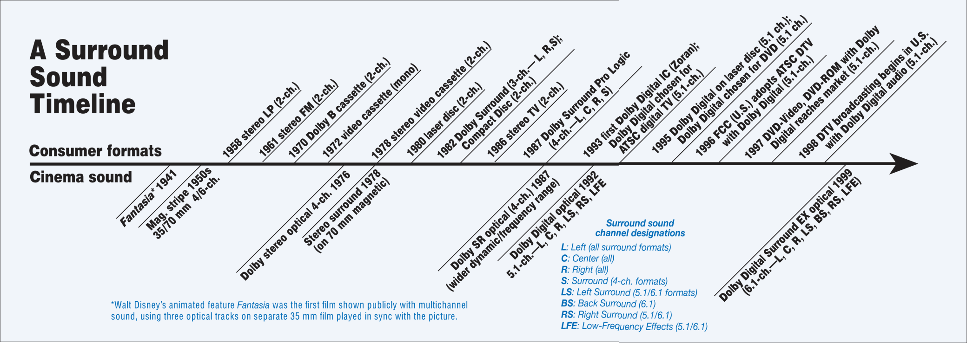
The Dolby Evolution
1941, Fantasia – First Multichannel Audio
1986 – Stereo TV!!
1987 – 4ch Pro Logic
1992 – Dolby Digital 5.1
Notes:
Dolby has been using multichannel surround since 1941. There are some important differences between the original dolby pro logic and todays 5.1 and 7.1 formats. The original surround was matrixed to a 2channel carrier format using phase inversion to reproduce the signal if rear channels were available on playback. Now the audio carrier is fully discrete and has separate metadata that contains information on the downmix settings for stereo reproduction.

Slide 35
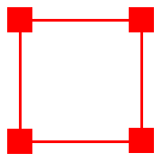
Early Attempts: Quadraphonic
Speaker spaced too far apart
Sounds are pulled towards speakers
Overall a worse experience than stereo
Proved inadequate by Michael Gerzon
Notes:
Quadraphonics was an ill fated surround format of the 1970s. It aimed at giving users a surround experience by placing four speakers in a cube, each separated by 90 degrees. However the angular distance between the speakers is far too great; creating gaps between speakers and pulling sounds towards the speakers. This doesn’t give the user a realistic playback environment and was in fact the target of quite a few of Michael Gerzon’s papers. He proved over and over the poor sound localisation of using this speaker array.

Slide 36
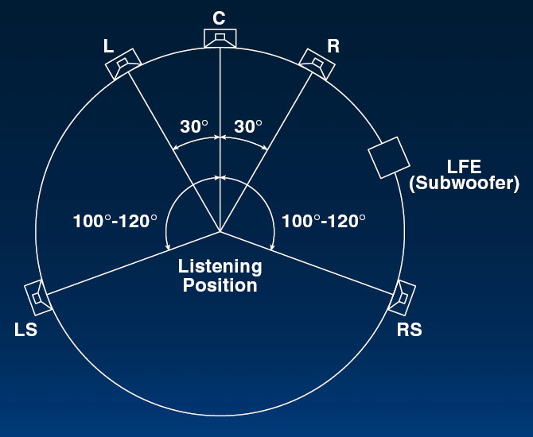
ITU Recommended 5.1
5 Full bandwidth channels
Low Frequency Extension channel
All speakers equidistant
Variations with rear channel at +/-135
Large Gap between surround channels
Notes:
Panning sources in 5.1 uses sine/cosine law.

Slide 37
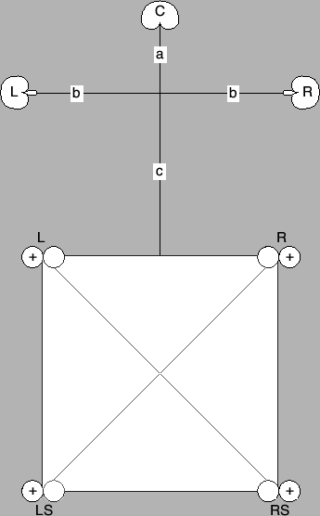
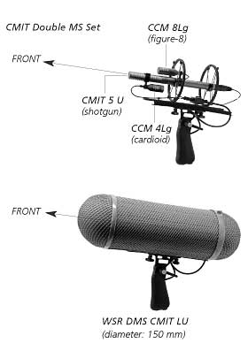
5.1 Recording Arrays
Hamasaki Square
Schoeps Double MS
Notes:
There have been many microphone arrays developed for recording in 5.0 or 5.1. Some of these are shown in the pictures and are Surround Decca Tree, Double MS and Hamasaki Square. These techniques have specific places where each microphone should be panned and quite often it can be a microphone per speaker arrangement. My personal favourite of these has been the Surround Decca Tree, which will be demonstrated later. One of the best attributes is that this method makes use of the law of the first wave front or the Haas effect. A Great resource for recording in 5.1 is Rumsey’s Spatial Audio.

Slide 38
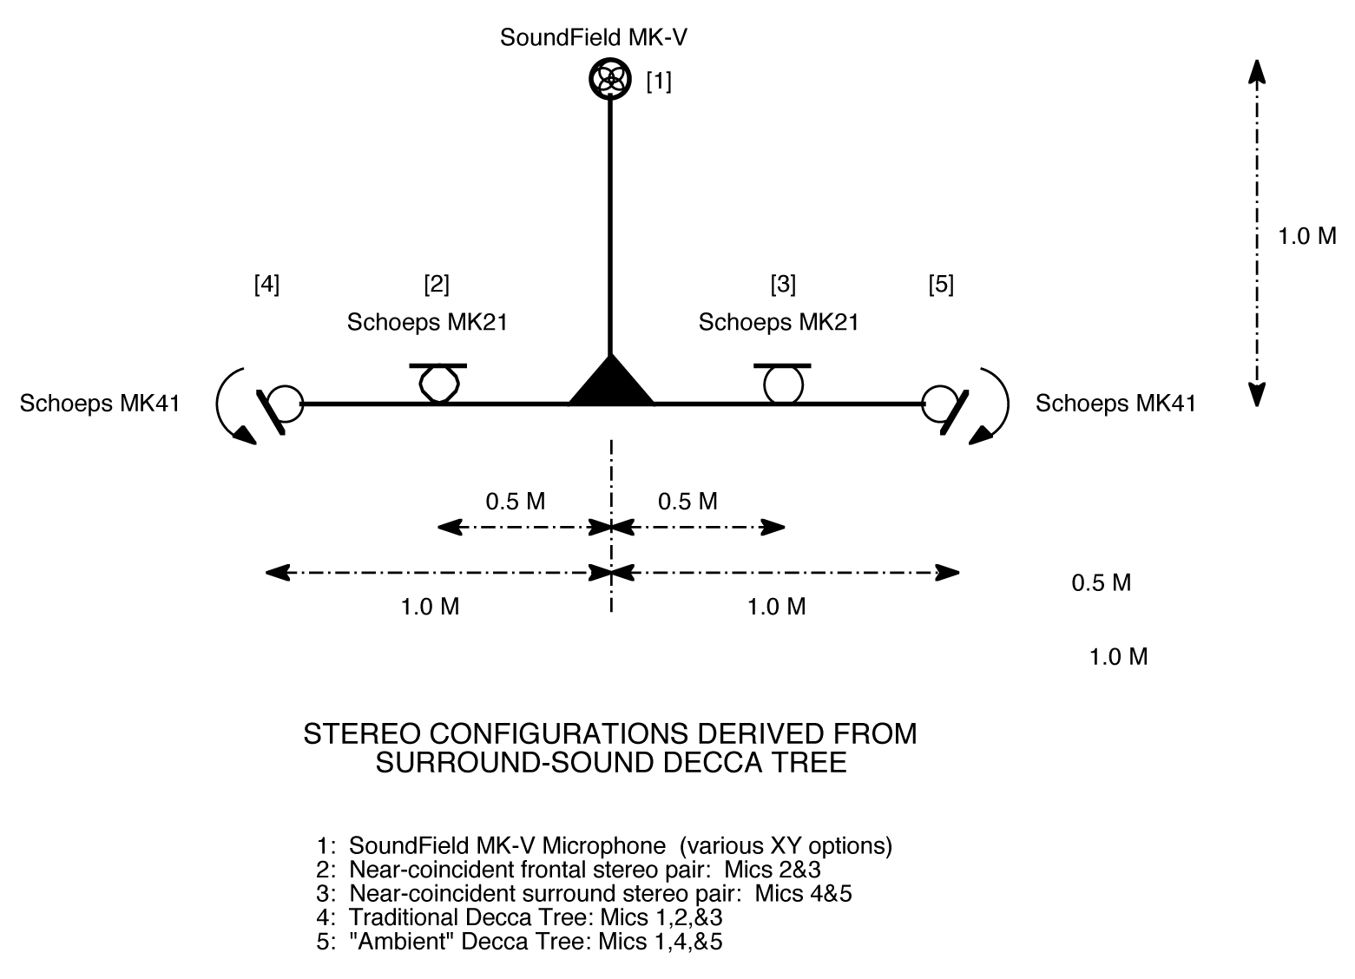
Surround Decca Tree
www.wesdooley.com/pdf/Surround_Sound_Decca_Tree-urtext.pdf
Notes:
The Decca Tree is a spaced microphone array most commonly used for orchestral recording
Talked bout: Correlation/Decorrelation, issues of stereo or mono compatibility

Slide 39

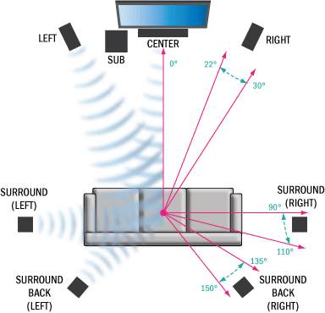
7.1 Speaker Layout
Notes:
In 7.1 the front 3 channels are in the same positions as 5.1. The 5.1 rear channels can be left in the same position but are now the side channels. The extra two channels are positioned at +/-135 to 150 degrees. To note when using 7.1 on some microsoft operating systems the side and rear channels are mapped the wrong way round.

Slide 40

Improvement over 5.1
Fills most of 5.1 gaps
Still suitable for home users
BluRay uses 8 uncompressed full bandwidth channels
192KHz 24Bit over HDMI 1.3
Backwards compatibility to 5.1 and its Dolby and DTS formats
Notes:
The improvements that 7.1 offers over 5.1 is filling some of the gaps between the speakers that were present in 5.1. By adding extra rear channels there is now not a 140 degree gap between surround left and surround right. And for accommodating the home user setup, there’s still going to be space between the sofa and tv to walk around the room.

Slide 41
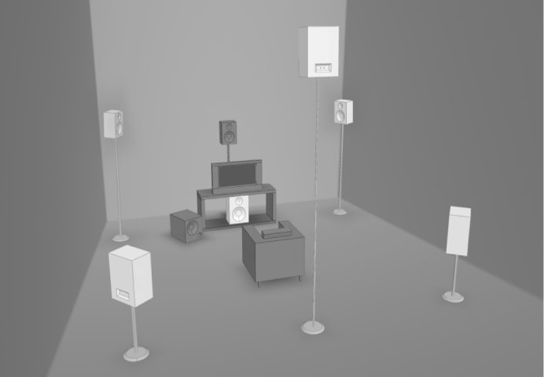
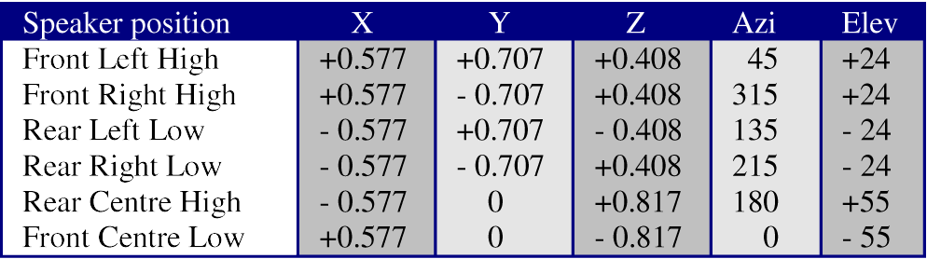
3D7.1
Almost compatible with 5.1
Gives height information
Uses a Tetrahedron for equidistant speaker locations
Notes:
At the latest AES Conference, Audio for Games, Simon Goodwin proposed a 3d speaker layout that he called 3D7.1. Simon worked within the limits of HDMI 1.3 where it is possible to have 8 uncompressed full bandwidth channels, though he actually used the limitations of 7.1 hardware and kept one channel as the LFE. He used Gerzon’s proposal from the 1970s of using a tetrahedron, so the speakers were equidistant from the user. The downside to this method is that there is limited height information and its only nearly 5.1 compatible.

Slide 42
3D7.1 Picture
Notes:
As can be seen in the picture the layout suggested is somewhat limited in its height reproduction around a 360 degree horizontal, notably with no speaker above the user. However based upon the hardware limitations it is a viable option and a step in the right direction for home 3D audio.

Slide 43
Ambisonics
Developed in the 1970s by Michael Gerzon
Based upon Spherical Harmonics
This is known as B Format Ambisonics
Notes:
Ambisonics was developed in the 1970s with most credit going to Michael Gerzon. This has been a system used by many for 3D playback since its introduction. Ambisonics is based on the principles of spherical harmonics. A sound source is given a chosen azimuth and elevation and based on these it is decomposed into directional elements. The W component is an omnidrection component, X is a front to back figure of 8 directional component, depending on literature Y is right-left directional component or vice verse and Z is an up down figure of 8 directional component. W is known as zeroth order and XYZ are called first order. These are known as the encoding equations, which are the main equations that people try to change to adapt ambisonics.

Slide 44
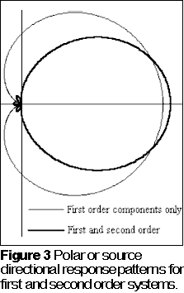
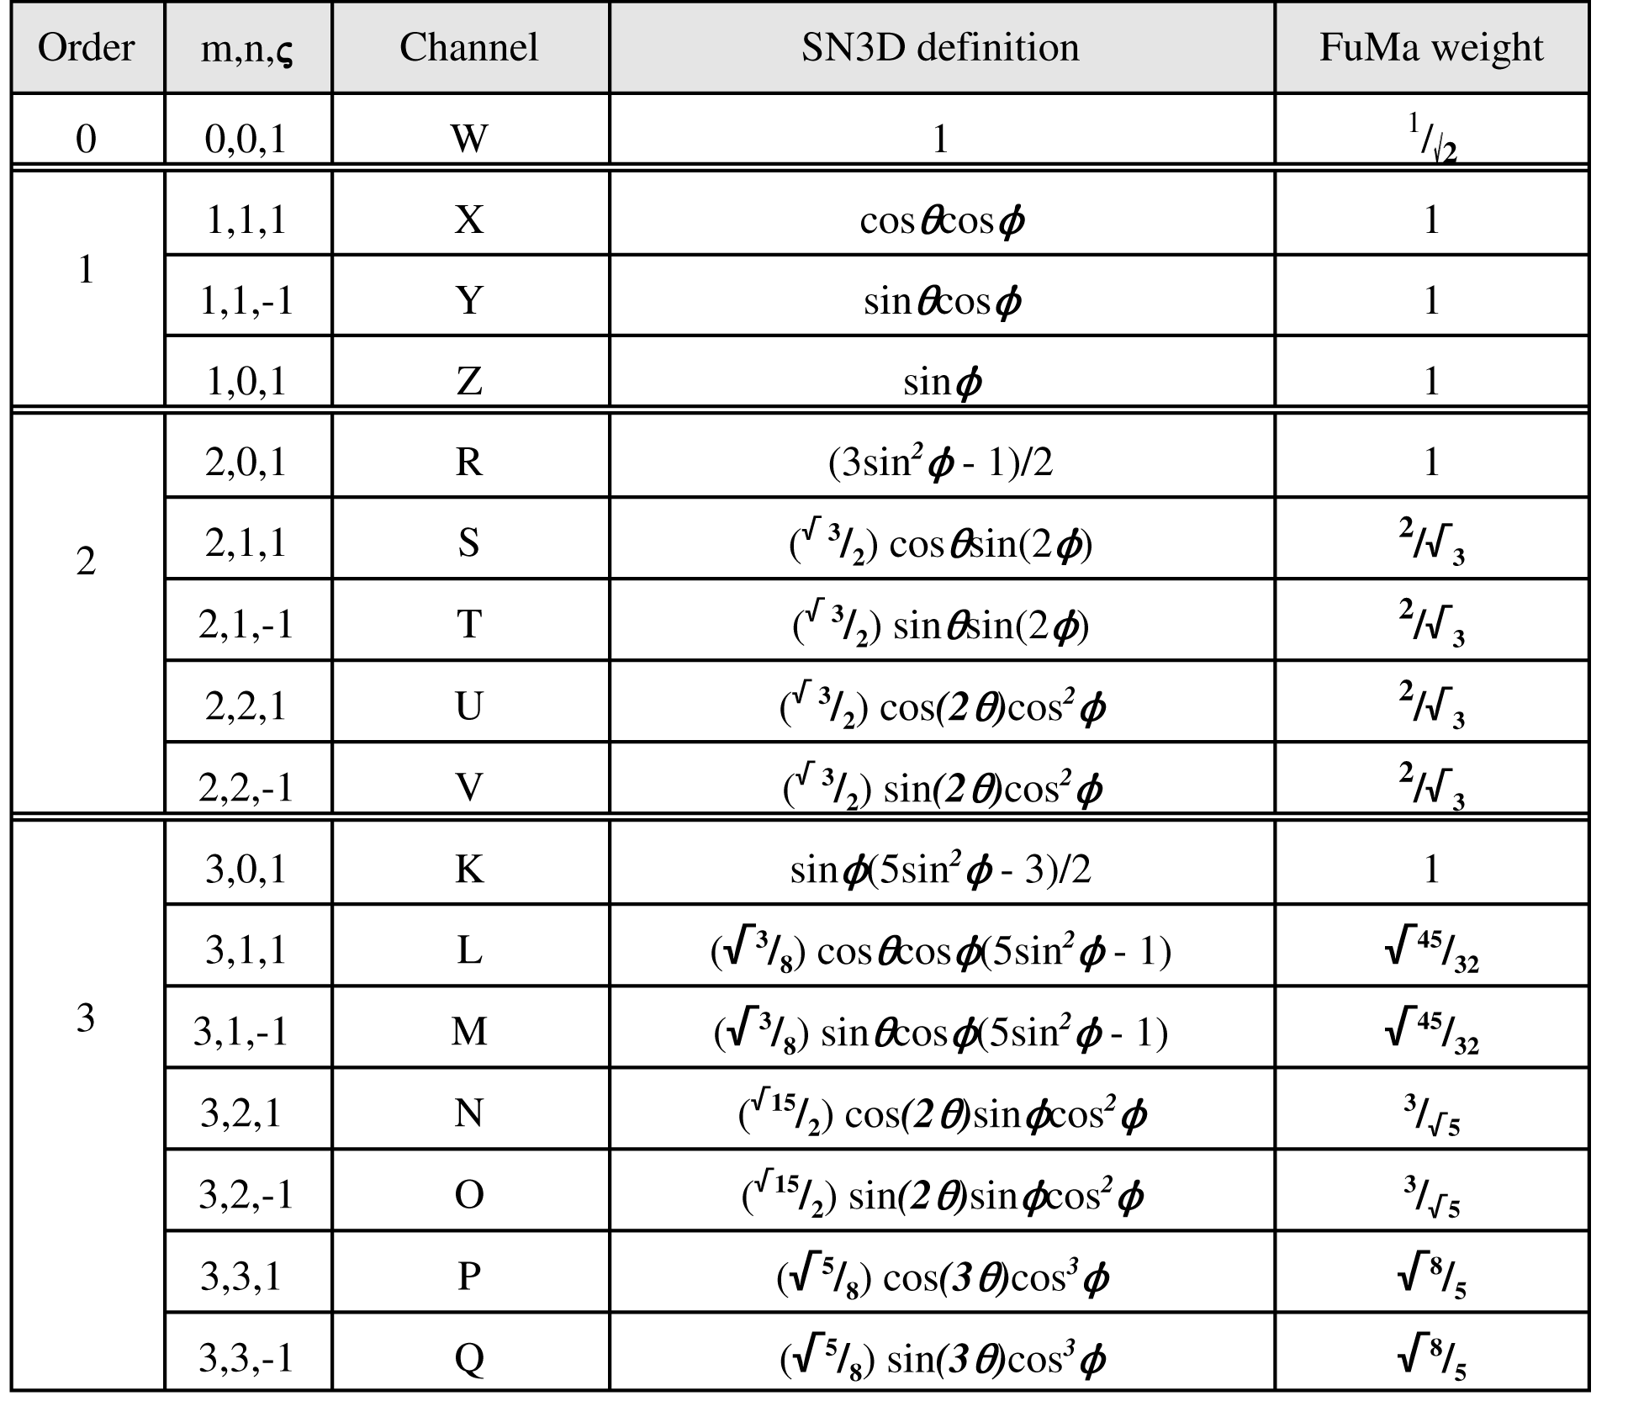
Higher Orders
Higher Orders Give Better Spatial Resolution
Notes:
The use of higher orders gives higher spatial resolution. Higher orders use more directional components, as the order increases the previous orders are always used as well, it is an additive system. You can see from the pictures that as the order increases the cardioid lobe produced becomes narrower with greater directional accuracy although more rear and side lobes are produce. The lobes, however decrase in amplitude as the order increases and spread over a wider area making them less distractive to the listener.

Slide 45
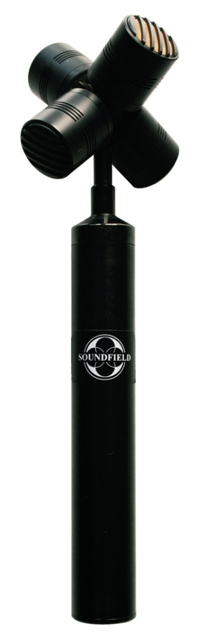
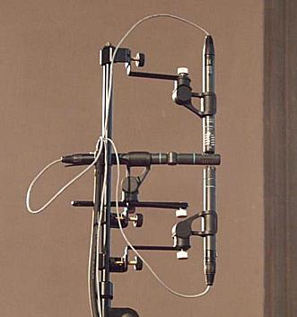
Recording Ambisonics
A Format Tetrahedral Microphone
Native B Format Microphone Arrays
Tetrahedral Arrays Are A Format Ambisonics
Notes:
Gerzon in his great wisdom helped develop the first Soundfield Microphone for recording ambisonics. Ambisonics from the beginning was both a format for recording, playback and panning synthesised sounds, this differs to any other format talked about here today. This uses a tetrahedral array of 4 microphone capsules which are known as A Format. These signals are then added and subtracted to produce the different W X Y and Z components for 1st order B Format. A Native B Format array can be set up using 3 figure of eight microphones to produce B Format. The picture show a Soundfield A Format Tetrahedral mic on the left and a native b format array on the right.
Ambisonics is prepanned and can be decoded to any speaker layout.
Lack of standardisation means no common users.

Slide 46
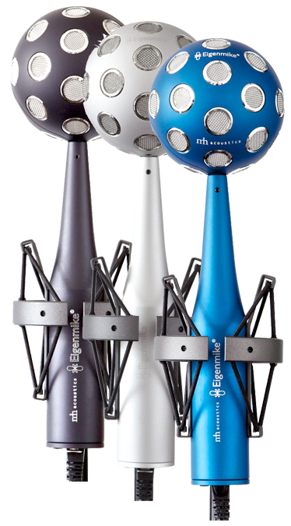
The Eigenmike
32-element microphone array

Slide 47
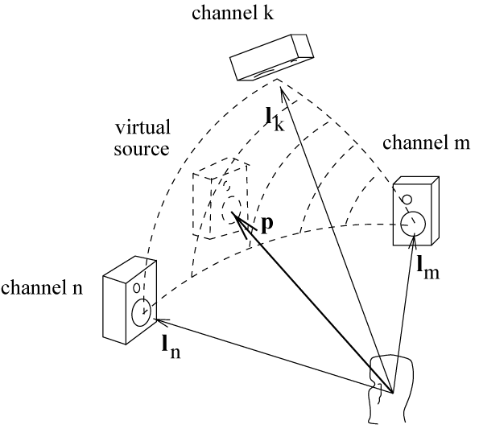
Vector Base Amplitude Panning
Uses a triplet of speakers to localise a source (3D)
Same as tangent law (2D)
Calculate speaker triplet vector same as the point source
Notes:
Like Ambisonics, vbap uses directional components to locate the point source. Using a triangulation based method, vector base amplitude panning uses three speakers in different planes to position a source, as seen in the picture. P is the point source and Ln, Lm and Lk are the speakers. If a source was panned between 2 speakers the resulting gains are identical to the tangent law. The vectors for speaker locations are calculated the same way as the point source vector.

Slide 48
Calculating VBAP Gains
P – point source
L – loudspeaker locations
Can also calculate gains of triplet using simultaneous equations or Cramer’s Rule
Notes:
The gains for speakers 1, 2 and 3 are calculated by multiplying the transform of the point source by the inverse matrix of the loudspeaker locations. Of course when using a 3D speaker array there are more than 3 speakers and the formula is applied to the active triplet. An active triplet is simply chosen by the triplet that the point source lies within. Once the gains have been calculated they are then normalised. There are alternates for calculating the gains such as simultaneous equations or Cramer’s Rule.

Slide 49
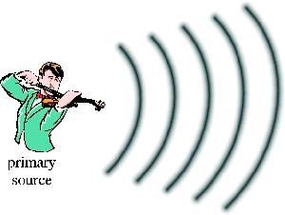
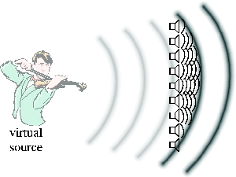
Wave Field Synthesis
Reproduces wave fronts
Highest frequency is determined by speaker distance
Downside is the amount of loudspeakers and cost
Notes:
Wave Field Synthesis is another system for audio playback. In this the user is surround by many loudspeakers. By the use of so many loudspeakers it is possible to produce wave fronts of sound therefore giving better directionality and clarity of sound, this can be seen in the picture of the violinsit. However wavefield synthesis has its frequency range limited by the distance between the speakers. A hybrid method can be implemented to use amplitude panning above the Wave Field Synthesis frequency limit for an arbitrary array.

Slide 50
Questions?
Dolby, www.dolby.com
DTS, www.dts.com
F. Rumsey, Spatial Audio, Focal Press.
R. Streicher, The Decca Tree – Its Not Just for Stereo Anymore,
http://www.wesdooley.com/pdf/Surround_Sound_Decca_Tree-urtext.pdf
C. Eric, T. Chen, “The Native B-Format Microphone by Benjamin,” Audio Engineering Society, Convention 119, 2005.
Schoesps, www.schoeps.de
V. Pulkki, “Virtual Sound Source Positioning Using Vector Base Amplitude Panning,” Audio Engineering Society, Volume 5, Issue 6, pp. 456 -466, June 1997.
S. Goodwin, “3D Sound For 3D Games – Beyond 5.1,” Audio Engineering Society, 35th
International Conference, 2009.
M.A. Gerzon, “Periphony: With-Height Sound Reproduction,” Audio Engineering
Society, vol. 21, pp. 2-10, February 1973.
D. Malham, Higher order Ambisonics systems,
http://www.york.ac.uk/inst/mustech/3d_audio/higher_order_ambisonics.pdf, 2003.
Soundfield, www.soundfield.com
Notes:
So has anybody got any questions about what I’ve talked about today?

